Slide 1
Recitation 9

Slide 2
Info
Jon Rutkauskas
Recitation: Tue 12-12:50
Office Hours: Tue 11-11:50 Thur 11-12:50 SENSQ 5806 (additional hours by appointment if needed)
On discord: @jrutkauskas
By email: jsr68@pitt.edu
Website: https://github.com/jrutkauskas/spring2019-449-rec
Ask me any questions you have!!!

Slide 3
Warmup Poll

Slide 4
Welcome Back
Hope you all had a good spring break
Project 3 is done! Lab 5 is done!
Great job! Project 3 is one of the hardest projects in this class, it’s smoother sailing from here.

Slide 5
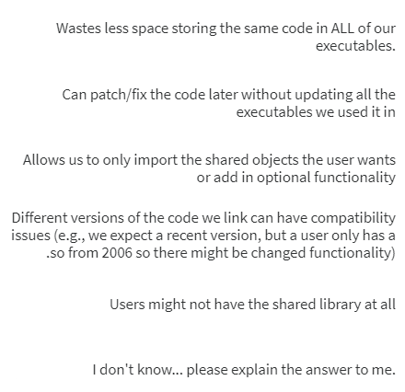
Which of these is -NOT- true of dynamic linking?

Slide 6
Which of these is -Not- true of dynamic linking?
Dynamic linking doesn’t copy any of the code of the data we want to link in, essentially it just tells the loader what functions to link in. E.g., we don’t have the code for fread in our executables, libc has it, we just link to it
When we link to a library, we can update that library without having to change a thing in the executables that link to it, when they are loaded again, the updated version of that library will be used.
Importing different SOs at runtime is a property of dynamic loading, not linking.
There absolutely may be compatibility issues with different versions, or different version requirements (e.g., we have 2 programs that each demand different, incompatible versions of a library)
Some libraries have to be installed separately.
Windows Users: Ever had to install dozens of “Visual C++ 200X Redistributable”s? – That’s this happening. (a necessary evil)

Slide 7
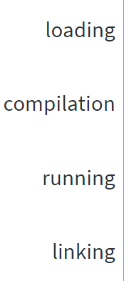
Rank the following operations in chronological order (farthest in the past first)

Slide 8
Rank the following operations in chronological order (farthest in the past first)
Compilation
Linking – Statically linked code is copied into your executable
Loading – Dynamically linked code is copied into memory with your program
Running – Any dynamically loaded code is loaded as requested

Slide 9
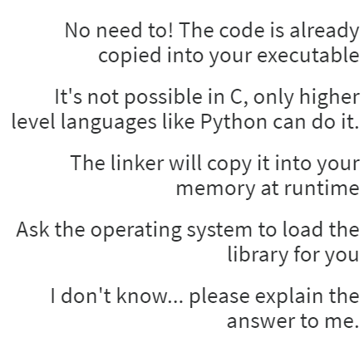
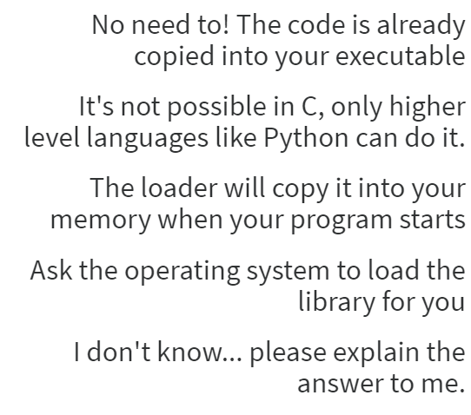
How do you dynamically load libraries?

Slide 10
How do you dynamically load libraries?
This is Static Linking, not Dynamic Loading
C absolutely can do this, we just learned it.
This is Dynamic Linking, not Dynamic Loading
The only way to dynamically load a library is by asking the operating system to do it for you, you can’t just execute any data you want without the OS’s permission

Slide 11
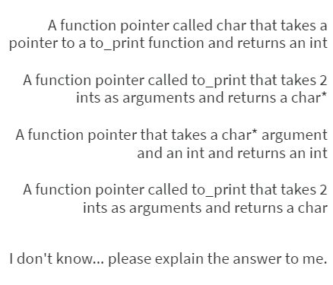
What type of function is this function pointer defining: char* (*to_print)(int, int);

Slide 12
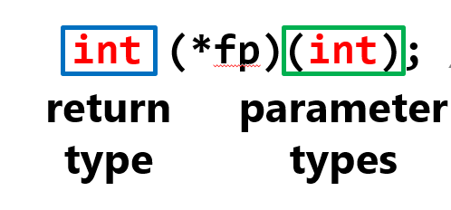
What type of function is this function pointer defining: char* (*to_print)(int, int);
Recall:
So, we have the char* as our return type, our pointer is called to_print, and we want that pointer to take 2 int arguments

Slide 13
Using this function pointer
#include <stdio.h>
char* yes = "yes";
char* no = "no";
char* all_greater_than_zero_string(int x, int y)
{
if(x > 0 && y > 0)
return yes;
else
return no;
}
int main()
{
char* (*to_print)(int, int);
to_print = &all_greater_than_zero_string;
printf(to_print(3,3));
return 0;
}
Kind of a -meh- use case, but perfectly good sample code.

Slide 14
Yeah, You totally should use Typedefs if you’re doing Function Pointers Frequently
Or at least try to avoid writing that complicated type all over the place
It’s a mess to read
While you might not need to memorize how a bunch of function pointers work, this is a useful skill, because they’re commonly used and look so dang scary.

Slide 15
What’s a Process?
No poll for this one. Good old-fashioned discussion?

Slide 16

What’s a Process?
A process is just an “in-memory representation of a program”
It’s an instance of a running executable
All of the code, data in memory (virtual memory), files open, etc.
A process thinks it’s the only thing running on your computer. It never knows if it’s paused for a bit to let other programs run, or where it is in real memory (not virtual), or what else is on the system. It’s just the process, and the operating system kernel… all alone

Slide 17
What’s Virtual Memory?
A Process’s Address space: The area within the realm of all possible 32 (or 64) bit addresses in which your process is allowed to access.
These addresses aren’t actually the physical memory addresses in your RAM
The OS and your CPU translate those fake ‘virtual’ addresses into the real memory addresses (using a page table)
Why? Protection. Additional features. Moving memory around. Placing processes in memory onto the hard drive when you’re running out of RAM. So much more.
Lots of 1550 fun stuff here. Feel free to ask me about it but you don’t need to know tooooo much about how it works for this class.

Slide 18
Lab 6?
Out sometime? It’s on something. Don’t let it slip past you. I’ll be available in OH on Thursday and on Discord anytime, just send a message if I’m offline and I’ll get back to you.
Last Updated: 12:40am
Actually it’s out now! Surprise!
Last Updated: 2:11am

Slide 19
Lab 6
We’ll be using a compression and decompression library: zlib.
Compression is the process of taking data, usually a file, and shrinking it down in size to save space. .zip, .gz, and .rar files are compressed.
You’ll learn some actual compression algorithms in 1501. We’ll just be using someone else’s code here.
How? Dynamic loading!!!!!
We’ll load the zlib library (libz.so) in our code, then extract the functions out.
It’s a really fun lab. Now you know how to add in additional functionality into your programs!

Slide 20
Lab 6
Recommendations:
Take your time, follow along with the lab instructions
Break up your code into smaller functions, like one for the dynamic loading, one for calling the compress function, one for calling the decompress function, etc. Do it in parts
You’ll be writing the compressed files out to stdout. Remember that you can do that with fwrite, and remember that stdout is a file that’s always available to you.
Take it through step-by-step, and don’t get discouraged.

